Slide 1
Social Network Analysis

Slide 2
Why Social Network Analysis (SNA)?
Enables us to segment data based on user behavior
Understand natural groups that have formed:
Topics
Personal characteristics
Understand who are important people in these groups

Slide 3

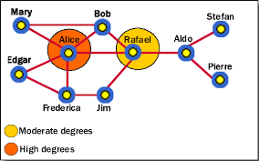
Analyzing Social Networks
Data Collection Methods
Surveys
Interviews
Observations
Analysis
Computational Analysis of matrices

Slide 4
Relationships

Slide 5
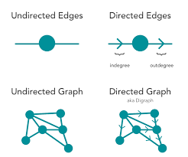
SNA Introduction
Directed Graph
Example: Twitter replies and mentions
Undirected Graph
Example: Family Relationship

Slide 6
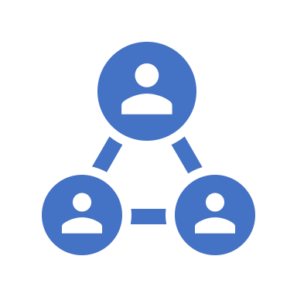
What is Social Network Analysis?
Research technique that analyses the Social structure that emerges from the combination of relationships among members of a given population (Hampton & Wellman (1999); Paolillo (2001); Wellman (2001))

Slide 7
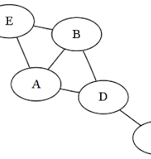
Social Network Analysis Basics: Node and Edge
Node
“actor” or people on which relationships act
Edge
Relationship connecting nodes
It can be directional.

Slide 8
Social Network Analysis Basics: Cohesive Sub-group
Cohesive Sub-group:
Well connected group, clique or cluster
Example: Orange, Green and purple

Slide 9
Social Network Analysis Basics: Key Metrics
Centrality
Number of direct connections that individuals have with others in the group (usually look at incoming connections only)
Measure at the individual node or group level
Cohesion (group measure):
Ease with which a network can connect
Aggregate measure of shortest path between each node pair at network level reflects average distance
Density (group measure)
Robustness of the network
Number of connections that exist in the group out of 100% possible
Betweenness (Individual measure)
Shortest path between each node pair that a node is on
Measure at the individual node level

Slide 10
Social Network Analysis Basics: Node Roles
Node Roles:
Degree
Betweenness
Closeness
Eigen vector

Slide 11
Measures of Central (Centrality)
Mean, Median and Mode
Degree (Mode)
Number of connection an actor has
Closeness (Mean)
Average distance between the node and every other nodes in the network
Betweenness (Median)
Boundary spanner between the 2 clusters
Eigen Vector
Connected to highly connected others
Connected to multiple high degree nodes
Random walk through the network you will come across nodes in proportion to the eigen vector centrality

Slide 12
Network Measures of Centrality
Degree
The number of edges connected to a node
Betweenness
Extent to which a particular node lies on the shortest path between other nodes
Closeness
The average of the shortest distances to all other nodes in the graph
Eigen vector
A measure of the extent to which a node is connected to influential other nodes. i.e. Google’s PageRank uses this measure
PageRank (PR) is an algorithm used by Google Search to rank web pages in their search engine results.

Slide 13
What do the measures tell me?
Degree
Exposure to the network, opportunity to directly influence
(high degree node is central to the network) (popular in the network)
Betweenness
Informal power, gate keeping; brokering; controls flow of info; liaison between sub-comp (informal leadership and informal power)
Closeness
Estimates time to hear info; Indirect influence; point of rapid diffusion (disease spread faster and rumors will be spread rapidly than the others)
Eigen vector
Connected to influential nodes of high degree; “not what you know but who you know” (network dense)

Slide 14
Centrality Measures: Degree
The number of links connected to a node
What do the degree measurement tell me?
Exposure to the network, opportunity to directly influence.
Possible target for collection of information on the network

Slide 15
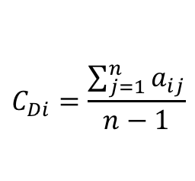
Calculating Degree
$$C_{Di}=\frac{\sum_{j=1}^{n}{a_{ij}}}{n−1}$$
Agent 2
AA | Agent 1 | Agent 2 | Agent 3 | Agent 4 | Agent 5 | Sum | Degree
Agent 1 |  | 0 | 0 | 1 | 0 | 1 | 1/4
Agent 2 | 0 |  | 0 | 1 | 0 | 1 | 1/4
Agent 3 | 0 | 0 |  | 1 | 1 | 2 | 2/4
Agent 4 | 1 | 1 | 1 |  | 0 | 3 | 3/4
Agent 5 | 0 | 0 | 1 | 0 |  | 1 | 1/4
Agent 1
Agent 4
Agent 5
Agent 3
Adjacency Matrix

